Slide 1


Learning
Management
System
Presented by
SeniHers Group 8

Slide 2
Topics
Problem we are solving
Overview
Why Flask
Different roles
Administrator
Educator
Educatee
Notification
Authentication
Forum - why and how
Demo
Some design decisions
Future Scopes
Learnings

Slide 3
Problems we are solving :
Non-centralized learning resources: At times all of a course's or batch's learning resources are not consolidated in one spot, resulting in a large number of resource locations and uncertainty.
Interactivity: As most of the learning and work has been shifted to online mode there must be an active one to one interaction between the teacher and student for smooth flow of tasks.
1
3
2
Tracking progress: Delivering and tracking of formal learning procedures is cumbersome and needs excellent management techniques.
4
Managing Incompetency: There are frequently no assignment reminders connected to deadlines for students, which may result in poor performance as students might miss out on them.

Slide 4

Overview
The Learning Management System is an EdTech application
Provides an Interface between Educator and Educatee
Important features:
Admin Control
Content Sharing
Assignments- Grade maintenance
Discussion forum
Notification
Built using Python Flask
Development Model: Iterative and Incremental

Slide 5

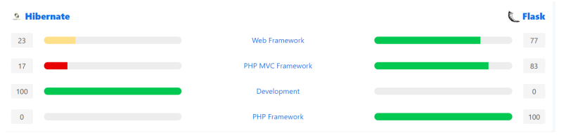






Lightweight
Simple to use But not limited functionality
Flask vs Hibernate
Why Flask?
Flask vs Django
Rapid development
Diversified working over Monolithic working style
Easy to learn

Slide 6
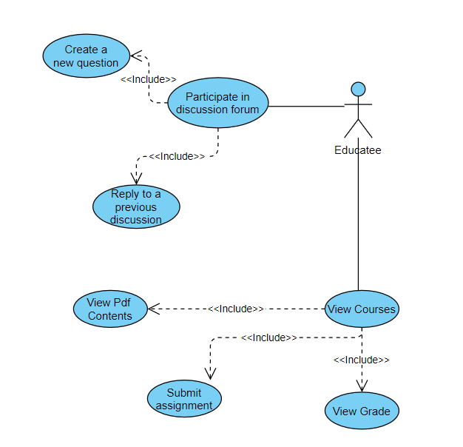
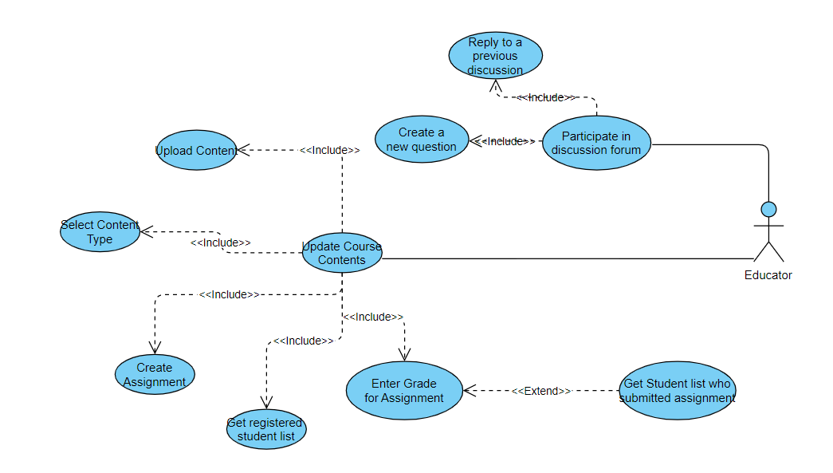
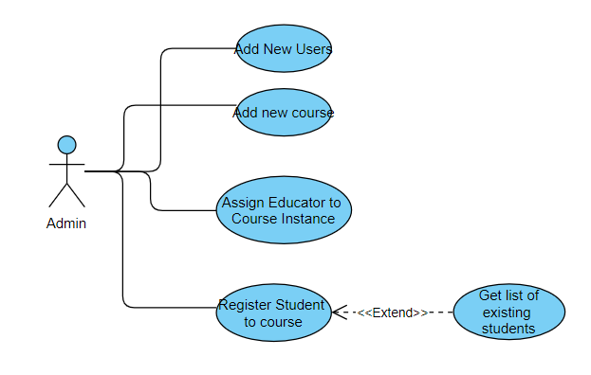
LMS has
Three Roles
Use Case
Diagram
Of
Admin
Use Case
Diagram
Of
Educator
Use Case
Diagram
Of
Educatee

Slide 7
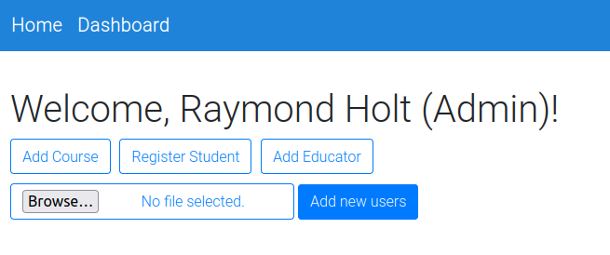
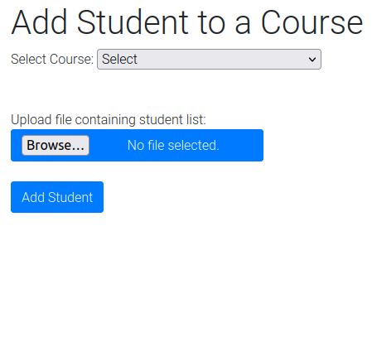
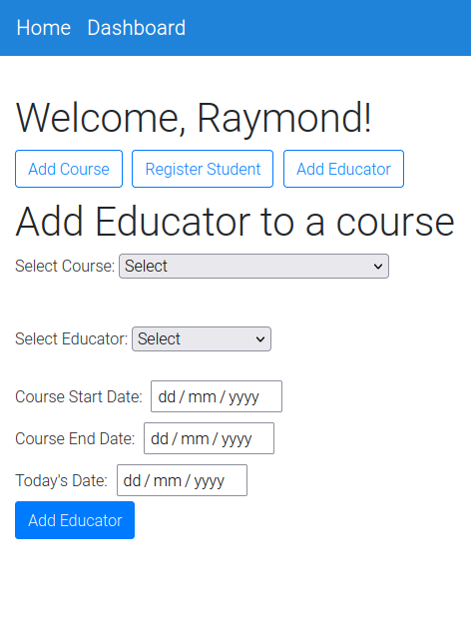
ADMIN
The Admin is responsible for:
Registering a user to LMS
Creating an instance of a course
Assigning a course to Educator
Adding Educatees to courses

Slide 8
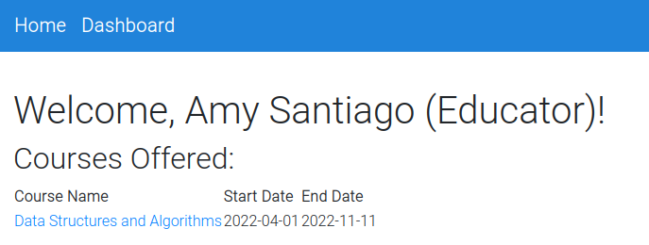
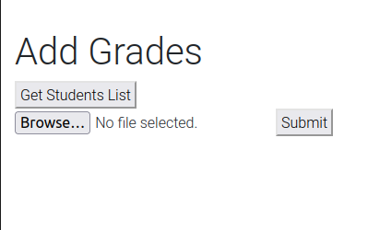
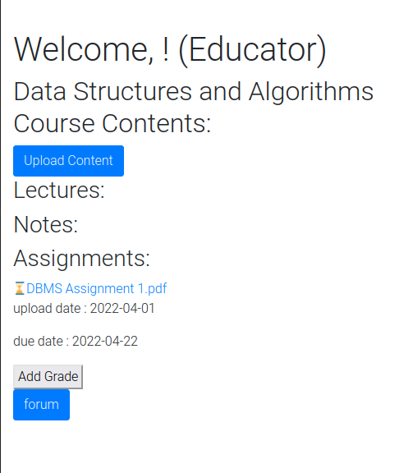
EDUCATOR
The Educator can perform the following tasks:
Upload notes, lecture content and assignments for educatees
Get list of students enrolled in his course
Add grades for assignments
Post/reply on discussion forum

Slide 9
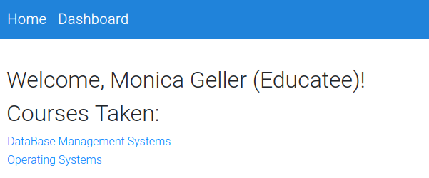
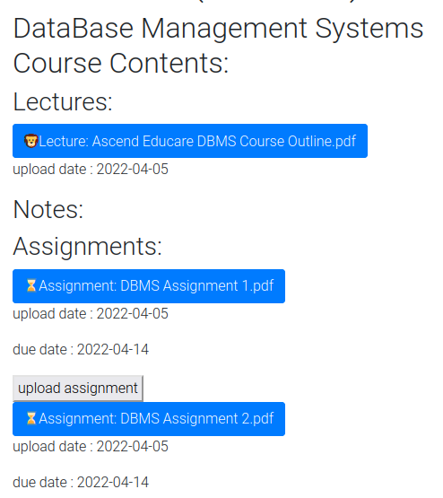
EDUCATEE
An educatee can:
View content notes and assignments for each subject he/she is enrolled in
Check due date of assignment and submit them
View grades
Post doubts/questions in discussion forum

Slide 10
Storage of PDF contents
Video lectures
Assignment submissions
Grades Management
Some Design Decisions
Content Management

Slide 11

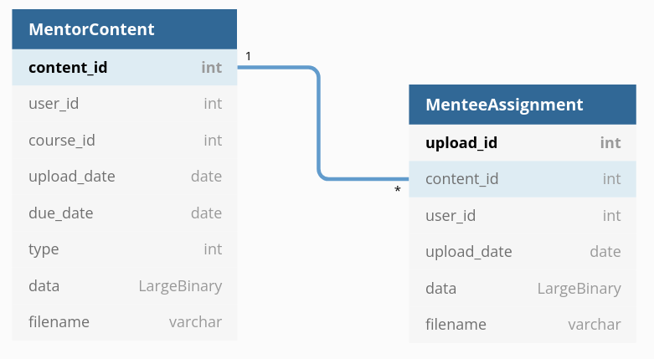
Schema for storing content and assignments
Table ‘MentorContent’ stores the content i.e. assignment, notes or lecture material uploaded by the educator.
Table ‘MenteeAssignment’ stores the submission uploaded by the educatees for the corresponding assignments.

Slide 12
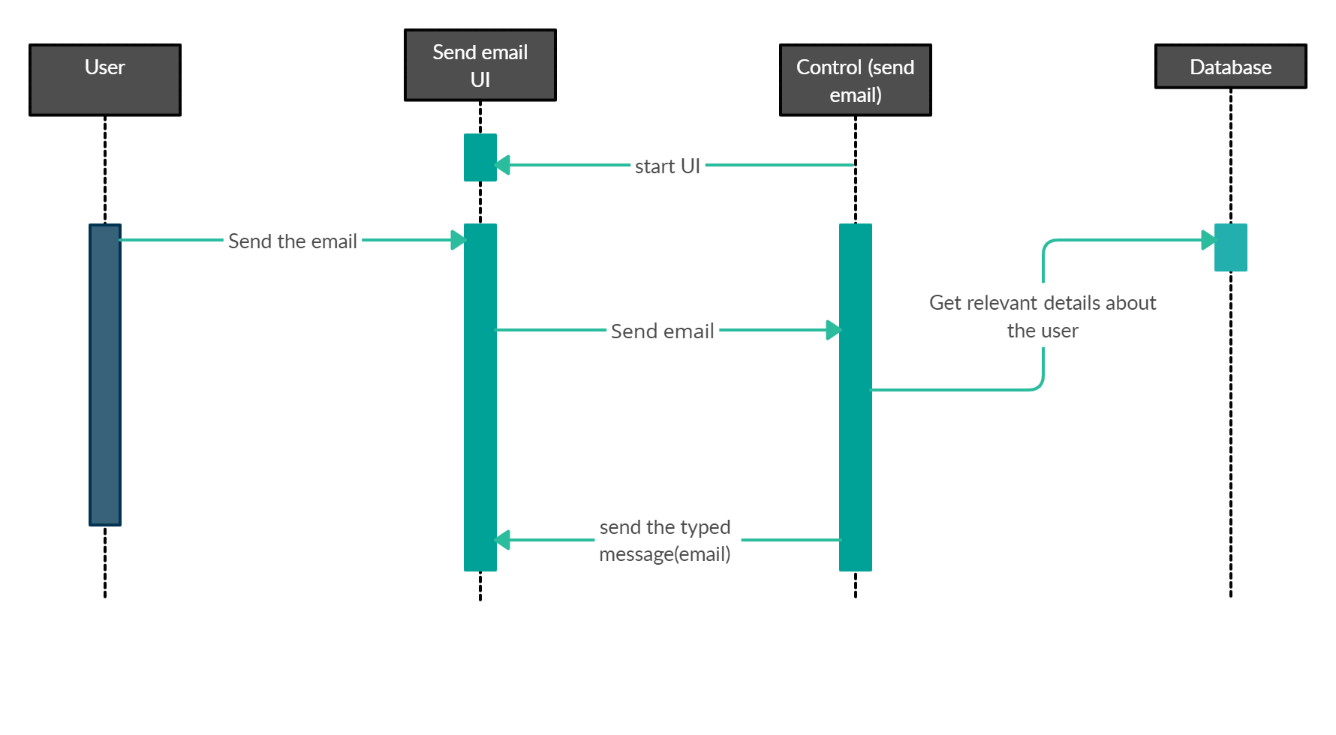
Notification Service (due date)
“Missed some assignments prior?You no longer need to be concerned because the note-i-fixation tool is at your service.”
This feature notifies the educatee about the assignment as soon as it is uploaded:

Slide 13
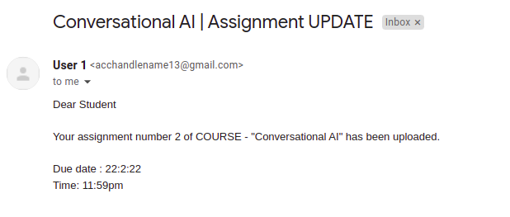
The email that we send is customizable
we can modify the content of the mail according to our requirement and needs.
Below is the email that will be received by the educatee:

Slide 14
Notification Service
Notifies the educatee 24 hrs before the assignment’s due date :
Database extraction, get due dates of assignments
Get students’ Email IDs linked to respective courses
Periodic job
SMTP to send mails
A new thread, running in background
Asynchronous environment, multiple threads

Slide 15
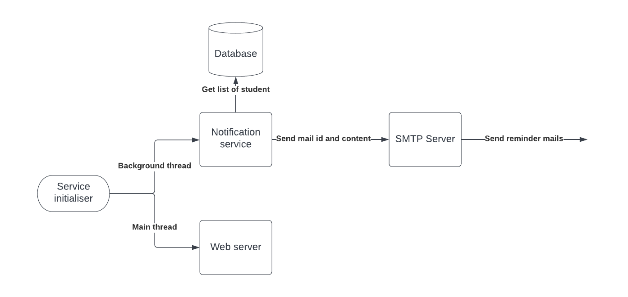
Implementation Workflow

Slide 16
Authentication
Flask-login module
Password hashed using SHA256
Salt added to password for added security
Session Management using
Flask-login
Flask-session

Slide 17
Discussion forum
In Discussion forum educators and educatees can participate in written discussions and exchange ideas, comments, questions and answers. Thereby encouraging peer to peer interaction and improving learner engagement.
01 | Each course has its own discussion forum
02 | Any member associated with the course can start a new discussion and members njnj can give replies by involving in it
03 | We can update or delete any post that we have posted
04 | The search feature in it allows us to fetch posts with the required keywords

Slide 18
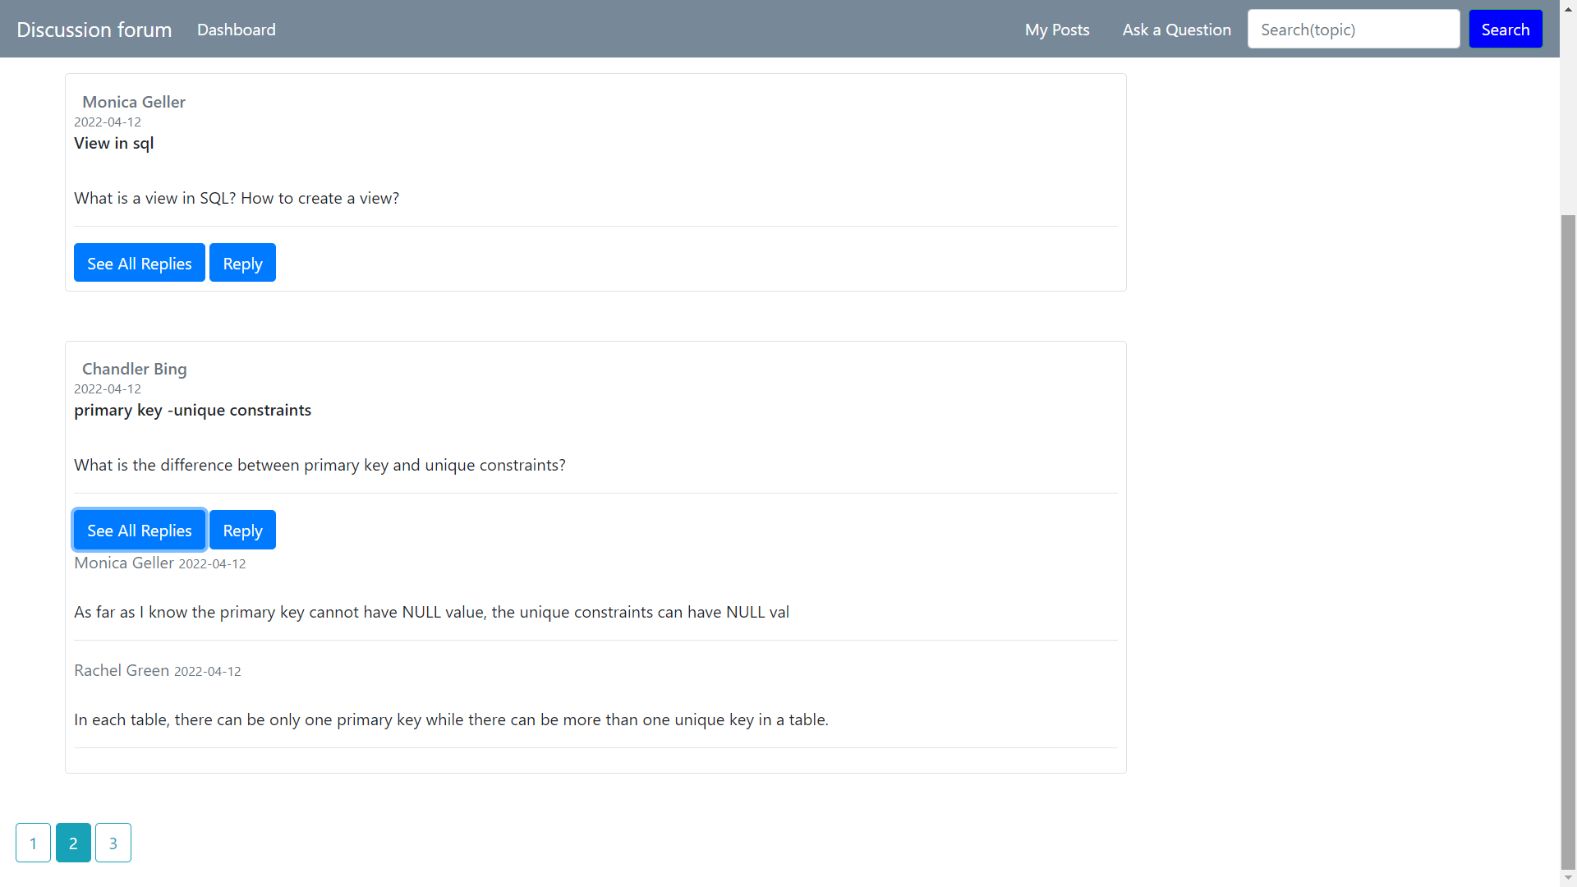
Discussion forum

Slide 19
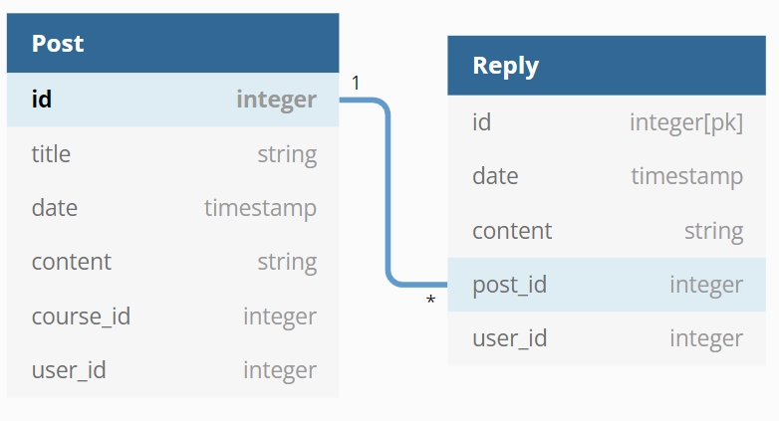
DB model for discussion forum
We have 2 tables in the db model. The Post table has all the posts whereas the Reply table has all the replies given to the posts
To fetch the posts in the discussion forum, the posts will be filtered by course id
To see replies for a particular post, replies would be filtered by post id

Slide 20
Demo

Slide 21

Demo

Slide 22
Future Work
An option for scheduling meetings
Adding more than one mentor per course
Personal schedule in the Dashboard
Adding own tasks in that schedule
Scaling the system to manage multiple institutions
Built-in exam portal - with autograding

Slide 23
Learnings
01 | Working in a Group Project
02 | Coming up with use cases and turning them into features
03 | Design decisions
04 | Identifying shortcomings and constantly improving them

Slide 24
Thank You

